Slide 1

Adaptive Cognitive-Load Study Timer for Personalized Break Scheduling
Revolutionizing student productivity with a privacy-first, adaptive learning tool.
The Problem
Our Approach
Students rely on fixed timers, ignoring natural cognitive load fluctuations. This leads to premature interruptions or prolonged exhaustion, reducing study efficiency.
A privacy-first app fusing typing/touch dynamics + micro-EMA. Features an Adaptive Scheduler, Chronotype Heatmap, and Intent-Lock overlay for personalized focus.
Estimator
Inputs typing and touch dynamics
Scheduler
Outputs adaptive work and break intervals
Student
Central adaptive agent receiving and sending data
Heatmap
Visualizes daily rhythm and peaks
Intent-Lock
Controls distractions to protect focus
Our system addresses critical gaps in existing static study tools, supporting millions of students.

Slide 2







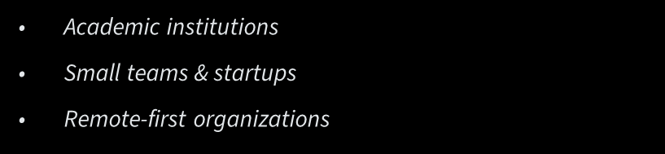

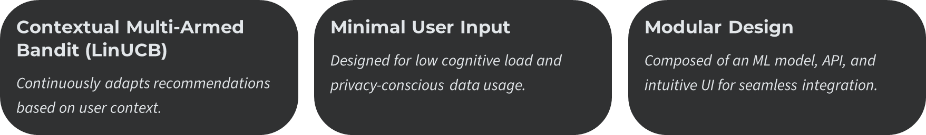

Slide 3
Key Features
Personalized Study Time Recommendation
Smart Scheduler
Uses a Contextual Bandit (LinUCB) model to recommend the most productive study time. And gives advanced insights about study pattern and how it improves.
Gives predictive study next windows to plan next session with machine learning powered application
Hourly Productivity Intensity Analysis to identify how student studies throughout weekly
LinUcb + Thompson sampling for smart adaptive timer scheduling
Enforce safety contraints for max continues work time , min brake frequency etc.
Reward — Progress (typing/focus or completion) plus post-break relief (cognitive load drop), with variance-based confidence and shaping (e.g. improved-focus bonus, deep-work-interrupt penalty, EMA adjustment). Immediate + delayed reward, clipped to [−1, 1]; bandit updated with (action, context, reward).
Time-block scheduling & metrics — User sets a time block; scheduler fills it with work/break intervals (optionally adapted from prior PG, AHL, SVR). Eight productivity metrics (PG, RPH, AHL, EOI, AUC-BUC, CTU, SPF variance, SVR) support evaluation and adaptation of the next session’s intervals.
Intentlock Overlay
Binary exit-intent classifier (impulsive vs genuine) using session duration + cognitive load
Uses CLE’s real-time cognitive load (latent_mean) as input
Logistic regression model, load-or-train on startup; cold-start uses 500 synthetic, research-backed samples
Adaptive friction
Three escalation levels by number of impulsive exits in the session:
Genuine exits get no friction; impulsive exits get friction that increases with repeated attempts
Congnitive Loading Estimater
Predicting congnitive load with user inputs such as mouse velocity , key strokes intervals
Micro-EMA Active Learning
Context Classification
Context classifier and Distraction tracker

Slide 4
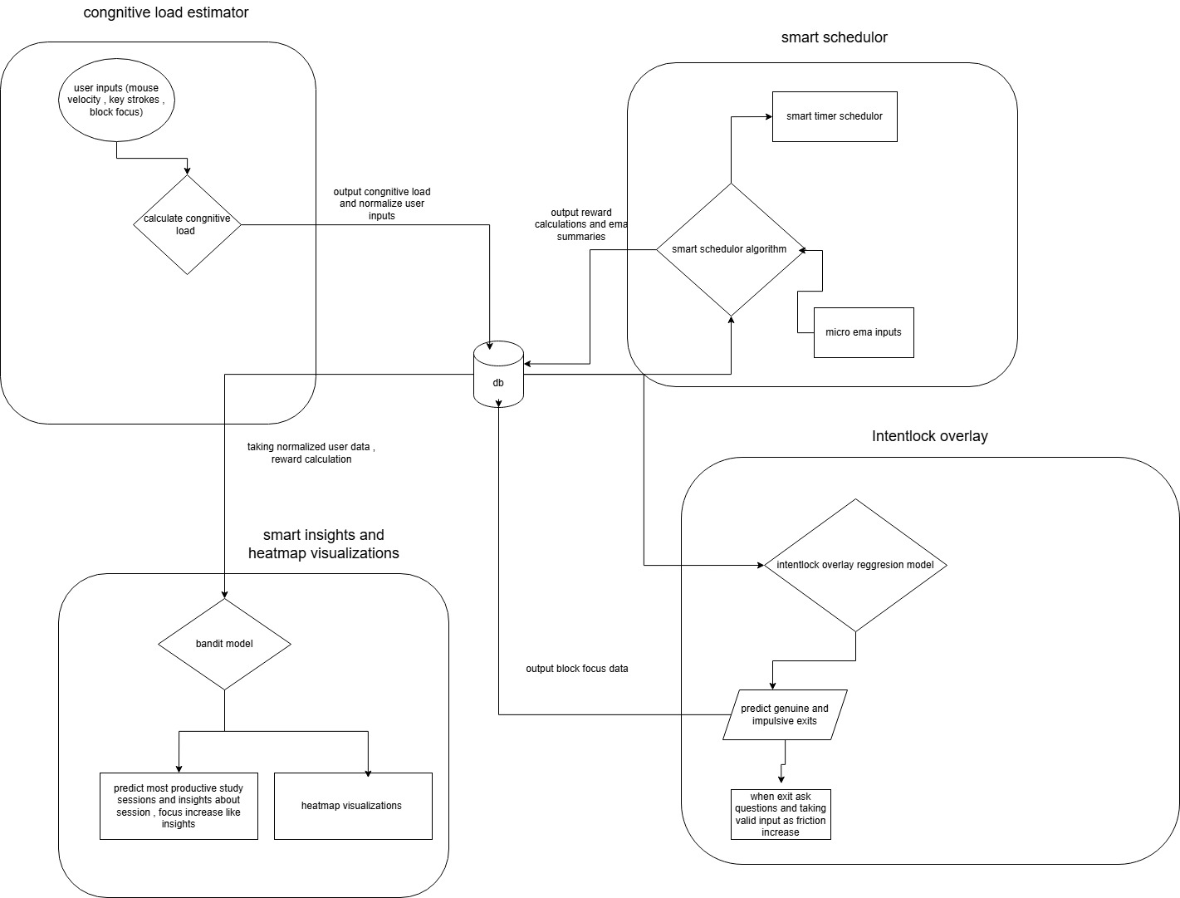
High level Architecture diagram
IT22148254
IT22054418
IT22087874
IT22276582
Our system addresses critical gaps in existing static study tools, supporting millions of students.
Notes:
The cognitive load estimator provides a score.
The contextual bandit takes that score plus context like typing rhythm and time of day.
It chooses the next work interval and break length.
The outcome is evaluated as a reward based on how much fatigue was relieved and how much progress was made.
Over time, it learns each student’s unique rhythm.

Slide 5








Adaptive Cognitive-Load Study Timer
Commercialization & Impact
Cost & Recovery
Customer Persona
Low development cost, subscription/licensing model
Introducing premium model , Introduce studend packages, recover within 6 months.
Students, self-learners, and professionals; integrate with LMS platforms to address their poor time management and lack of awareness in productivity pattern
What Is Unique
Market Size
Adaptive recommendation for students based on past data and real time congnitive load , gives explanable insights.Use ml with visualizations
Initial target markets are students , free lancers, remote workers
1M+ students use Pomodoro apps; capturing even 1% market (~10k users) at $2/month yields $20k monthly revenue.

Slide 6

References
IEEE Referencing Format
[1] Zerbini, G., et al. (2017). "Time to learn: How chronotype impacts education." PsyCh Journal, 6(4), 263-276. Available at:
[2] Goldstein, D., et al. (2023). "Chronotype, Time of Day, and Performance on Intelligence Tests in the School Setting." Behavioral Sciences,
[3] Nguyen, T. M., et al. (2023). "A Review on Smartphone Keystroke Dynamics as a Digital Biomarker..." Brain Sciences.
[4] Vollmer, C., et al. (2023). "A better alignment between chronotype and school timing I
s associated with lower grade retention in adolescents." npj Science of Learning, 10, 25.
[5] Goldin, A. P., et al. (2017). "Lower school performance in late chronotypes: underlying factors and mechanisms." Scientific Reports, 7, 4385:
[6] Chen, Y., et al. (2023). "Adaptive Sequence Learning: Contextual Multi-armed Bandit Approach." IEEE International Conference on Data Mining.
[7] Lan, A., et al. (2016). "A Contextual Bandits Framework for Personalized Learning Action Selection." Educational Data Mining. Available at:
[8] Hunziker, A., et al. (2020). "Reinforcement Learning for the Adaptive Scheduling of Educational Activities." Proceedings of the 2020 CHI Conference on Human Factors in Computing Systems.
IT22276582 – Yasasvin W.M.Y
IT22276582 | Yasasvin W.M.Y | 25-26J-458

Slide 7
[9] Multi-Armed Bandits for Intelligent Tutoring Systems. Journal of Educational Data Mining (2015). Available at:
[10] Expert Features for a Student Support Recommendation Contextual Bandit Algorithm (2024). Proceedings of the 14th Learning Analytics and Knowledge Conference.
[11] An Overview of Contextual Bandits (2025). Towards Data Science
[12] Dynamic Linear Epsilon-Greedy: A Bandit You Can Trust (2023). Proceedings of the 31st ACM Conference on User Modeling, Adaptation and Personalization.
[13] Contextual Bandits as Supervised Learning (2024). True Theta
IT22276582 | Yasasvin W.M.Y | 25-26J-458

